Slide 1
Zoncave Death Escape
3D Virtual Reality Game

Slide 2
Virtual Reality
Artificial Reality -> Virtual Reality and Augmented Reality.
The immersive environment resembles almost every possible similarity to the real world to create a lifelike experience grounded in reality of sci-fi.
Basically VR provides an edge to see through Worlds without delay even can feel them .

Slide 3
Why Gaming !!!
Gaming is an Obvious Application of VR , can show every possible world through games .
Via Game each age group of people can get something of their demand . Of course it does not have an END .
We can enjoy overwhelming imaginative worlds via VR games , by being virtually present there , isn’t it really good to feel the worlds which can only be present in thoughts or shows.

Slide 4
Cntd…..
Another side a VR game can let us know real worlds . One can do any kind of activity via games , which they ever wanted of. Eg. Car racing, Roller coaster , Virtual maze and many more.
Fantasy is we at every age of life want to play games to refresh us And in this busy life of nowadays what can be better then a Virtual World to play in .

Slide 5
This VR Game --
Zoncave Escape is build using Unity Game Engine .
You are lost in a world of caves and zombies.
Get the key and find your way to your home.
Beware of Zombies.
A gun is provided to defend yourself .
Crystals increases health.
Feel Virtually created creepy World . Play for your life .

Slide 6
Utilities Of Virtual Reality
Almost in every field VR is in use . In Every other field be it tech , medical, or Film Industry VR is in need .
Have various used in medical field. No need of dissecting living organisms. You can create a 3D virtual organism and perform experiments on that.
Useful in training field. Useful in learning driving, War trainings, etc.
Can cure depression. Eg, Vanila Sky :p

Slide 7
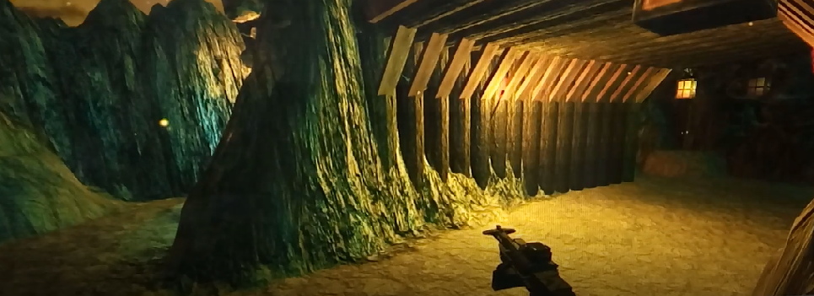
Some Glimples

Slide 8
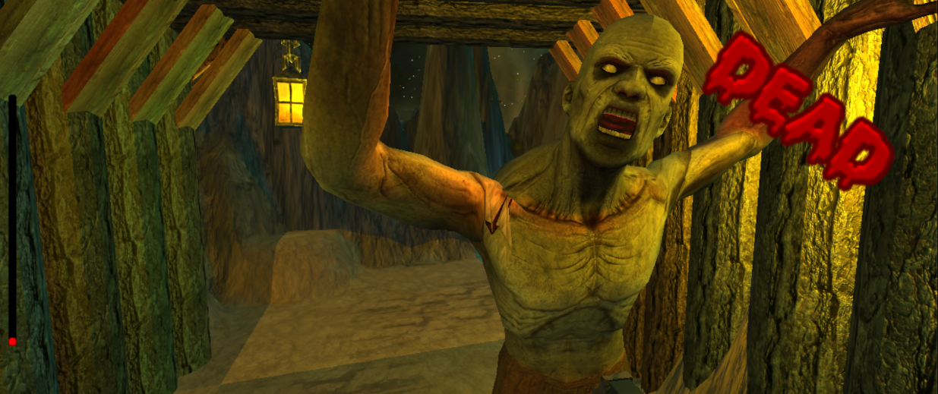

Slide 9
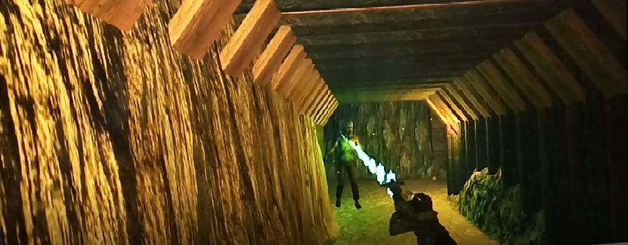

Slide 10
